Slide 1


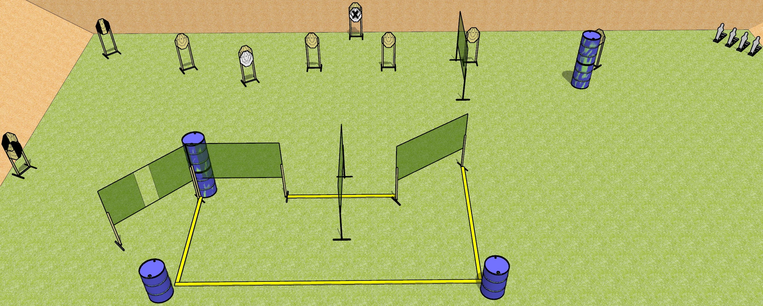
 | Dothan Gun Club – USPSA Match Coast to Coast Course Designer : Drew Coleman
START POSITION : Both hands flat on marks on either barrel (barrels along rearmost fault line)
GUN READY CONDITION : Firearm placed on opposite barrel from start position, loaded safety on, trigger guard on mark barrel perpendicular to back berm. |  | SCORING: Comstock, 24 rounds TARGETS: 10 paper, 4 Steel SCORED HITS: Best 2 on paper, steel until down START-STOP: Audible, last shot RULES:
STAGE PROCEDURE: Engage targets as they become available from within the fault lines

